Slide 1
Review Group 3
SureThing architecture document of
Huanwen Qu
Jinfeng Zhu
Rodrigo Baptista

Slide 2
Reviewers
Team 1:
Bogdan Dumitriu
Marjolijn Elsinga
Sébastien Raveau
Reinier Vis

Slide 3
Contents
Positive things
Things for improvement
Costs
Possible change scenarios
Risks
Conclusion

Slide 4
Positive things
Cost section
Consistent views
All views are very understandable and clear
Evolution view: helpful and useful
All stakeholders are considered
Functional requirements are identified
Views are documented with UML

Slide 5
Things for improvement
Evolution viewpoint is defined, the other viewpoints are not
Concerns are identified to a small extent
Quality issues are not defined at all
Structure of document:
  No guide for stakeholders
  Early introduction of terms of system, with later explanation
Why not do the overtake of UCIS by BusNet right away?

Slide 6
Costs
Costs are too high
  Developer hours could be less if Java was used instead of .Net technology
  To many servers used
  Expensive firewall not necessary
Usage of .Net technology is not justified
Costs for developer hours are not either

Slide 7
Possible change scenarios
Blacklist example
Internet Information Services (IIS)
Stiff scalability

Slide 8
Blacklist example (1)
Suppose: SureThing wants to exchange their blacklist of naughty customers with other insurance companies
Not paying fees
Multiple insurances at different companies
Making illegal claims
And so on…

Slide 9
Blacklist example (2)
Blacklist component communicates with:
  Customer database
  BusNet
  UCIS

Slide 10
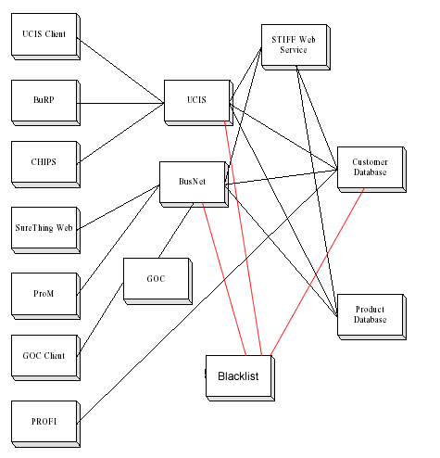
Blacklist example (3)

Slide 11
Blacklist example (4)
Drawback:
duplicated code in both UCIS and BusNet components
Conclusion:
UCIS and BusNet are doing the same things

Slide 12
Internet Information Services
Suppose: an investigation by NSA tells that IIS has major security problems
Replacing IIS with another webserver will be hard. There are few webservers that support ASP.NET
Lack of portability: it runs only on ASP/ windows systems and not on other OS’s

Slide 13
Stiff scalability (1)
Suppose: the number of customers grows significantly so that Stiff cannot calculate the proposals in real time any more
Consequence: the number of Stiff components has to be enlarged

Slide 14
Stiff scalability (2)
Drawback: Stiff is still the old batch based program, therefore it is impossible to:
  run multiple threads and ensure that each of the threads computes different proposals

Slide 15
Risks
Scalability of Stiff
Fault tolerance
Internet Information Services / security
Back-up of data
Hardware failures

Slide 16
Conclusion (1)
Positive remarks:
  Nice modular architecture
  Updating will be easy to do
  Consistent document

Slide 17
Conclusion (2)
Negative remarks:
  System is not scalable
  Updating of the core will be hard
  Quality issues are not identified
  Concerns are not identified and therefore not addressed
  Costs are high

